Slide 1

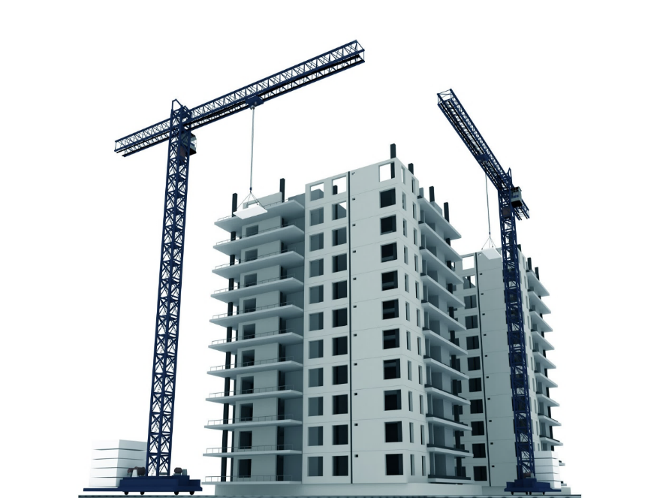
HI-TECH PROJECTS Pvt. Ltd.
PROJECT REVIEW MEETING
PROJECT NAME: PSC & PLUG POINT BUILDING AT ODHAV
PRESENTED BY: TORRENT ODHAV TEAM

Slide 2
PROJECT DETAILS
Project: | PSC & PLUG POINT BUILDING
Client: | TORRENT POWER LIMITED
Architect: | MUNJAL BHATT ARCHITECT
Structural Consultant: | DUCON CONSULTANT PVT. LTD.
Consultant: | TUV
Tender Cost | 35.51 Cr.
Start Date (As per PO): | 13/08/2018
Finish Date (As per PO): | 30/09/2021
Actual Start Date: | 15/09/2018
Finish Date (As per Bar Chart) | 28/02/2022 (As per ERP) (As per revised bar chart 30/04/2022)
Total Duration Vs Lapsed in days | 1295 total duration /15 lapsed days
Project plan Vs Achievement | 35.51 Project plan /26.75 Achievement (Claimed)
Billing Till Last Month:- | 26.75 Cr. (Claimed + Extra + Exhausted)
PROJECT REVIEW MEETING Jan’22

Slide 3

REVIEW OF LAST MOM
MOM - PROJECT REVIEW MEETING
DEPARTMENT |  |  | Date
PARTICIPANTS
Sr. | Agenda Points | Key Measurable / Action to be Taken | Responsible Person |  | Target Date | Progress Status | Action Taken
1
2
3
PROJECT REVIEW MEETING Jan’22

Slide 4
PLAN V/S ACTUAL
Project Value | For the month of Jan’22 |  |  |  | Cumulative for the Project up Jan’22
 | Sales as per Bar chart | Sales as per Feasibility | Sales (Client Bill) | % Achievement | Cumulative Sales as per Bar chart | Cumulative (Client Bill + WIP) Sales | % Achievement wrt Bar chart
A | B | C | D | E = D/C | F | G | H = G/F
3551 | 191.38 | 126.92 | 55.77 | 43.94% | 3551 | 2675 | 75.33%
Sr. No | Description | Qty | Unit | Rate | Amount | Reason
1 | SUPPLY LAYING AND COMPACTION OF 230MM THICK RUBBLE | 30 | Smt | 504 | 15120 | We have received revised Infra Drawing from client for Gantry Column in CP area (05.01.2022)
2 | M10 GRADE FOR PCC INCLUDING SUPPLY OF CEMENT WITH 30% FLYASH | 50 | Cmt | 4636 | 231800
3 | COBBLE STONE FLOORING | 315 | Smt | 2337 | 736155
4 | INTEGRAL PENETRATING CRYSTALLINE WATERPROOFING TREATMENT | 315 | Smt | 569 | 179235
5 | TERRACE GARDEN WATERPROOFING SYSTEM "TEXSA" OR APPROVED EQUIVALENT | 315 | Smt | 980 | 308700
6 | 40THICK FRP GRATING | 600 | Smt | 4122 | 2473200 | Depends on vertical Garden
7 | Fabrication with MS TUBULAR SECTION | 18 | MT | 118951 | 2141118 | Less Manpower
8 | STEEL INSERTS | 2550 | Kg | 121 | 308550
9 | FABRICATION WITH HOT ROLLED SECTIONS | 3.96 | MT | 108113 | 428127
10 | THREE COATS OF PLASTIC EMULSION PAINT | 770 | Smt | 258 | 198660 | Client Hold (Current Permission for 1st coat putty)
 | Total Amount |  |  |  | 7020665
PROJECT REVIEW MEETING Jan’22

Slide 5
NEXT QUARTER PLAN
HI TECH PROJECTS PVT. LTD.
PROJECT: - | Torrent Power Odhav
MONTH:- Jan-22
Project Value (in lacs) | Cumulative Bill Achieved up to previous month | % Completed | Feb-22 | Mar-22 | April-22 | Quarter's Target | Balance Amount | Remarks
 |  |  | Amount | Amount | Amount | Amount
A | B | C = B/A | D | E | F | G = D+E+F | H = A - (B+G)
3551 | 2675 | 75.33% | 82.00 | 100.17 | 225 | 407.17 | 469 | Revised WO is under process.
PROJECT REVIEW MEETING Jan’22

Slide 6
MANPOWER STATUS
Row Labels | Manpower Requirement for March’22 |  |  | Total Available in Feb’22 (13/02/2022) | Shortfall
 | Skilled | Unskilled | Total
A | B | C | D=B+C | E | F=D-E
Reinforcement | 2 | 2 | 4 | 2 | 2
Shuttering | 2 | 2 | 4 | 2 | 2
Trimix | 2 | 2 | 4 | 0 | 4
Rendering | 2 | 3 | 5 | 5 | 0
Fabrication | 8 | 8 | 16 | 9 | 7
Punning | 1 | 1 | 2 | 2 | 0
Flooring | 3 | 3 | 6 | 8 | -2
Painting | 4 | 4 | 8 | 0 | 8
Masonry Plaster | 2 | 4 | 6 | 8 | -2
Unskilled | 2 | 10 | 12 | 8 | 4
Plumbing | 1 | 1 | 2 | 0 | 2
Waterproofing work | 4 | 4 | 8 | 2 | 6
Aluminium work | 2 | 2 | 4 | 0 | 4
Grouting work | 5 | 0 | 0 | 0 | 0
Total Manpower |  |  | 81 | 46 | 35
PROJECT REVIEW MEETING Jan’22

Slide 7
LAST 3 MONTH VALUATION
STOCK VALUATION
Category Name | Dec-21 | Jan-22 | Feb-22 (Up to 13/02/2022)
Consumable Asset | 5.64 | 6.04 | 6.48
Material | 77.47 | 52.96 | 55.76
Oil & Fuel | 0.01 | 0.02 | 0.01
Spare part | 0.17 | 0.16 | 0.16
Total | 83.29 | 59.18 | 62.41
Amount in Lacs.
PROJECT REVIEW MEETING Jan’22

Slide 8
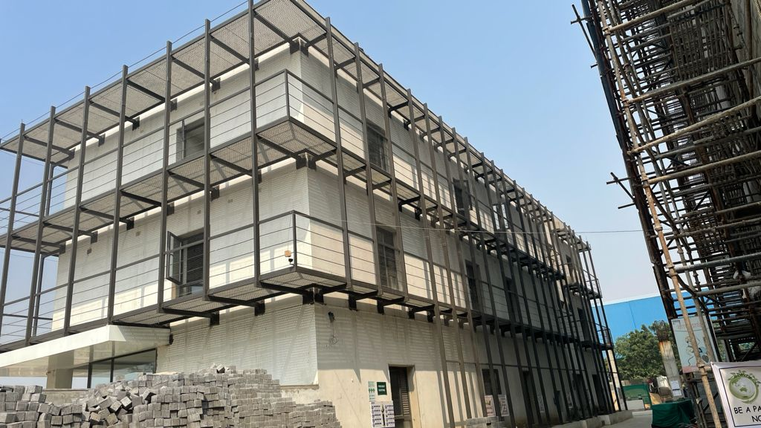
PROJECT CURRENT STATUS PHOTO’S
Plug Building
PROJECT REVIEW MEETING Jan’22

Slide 9
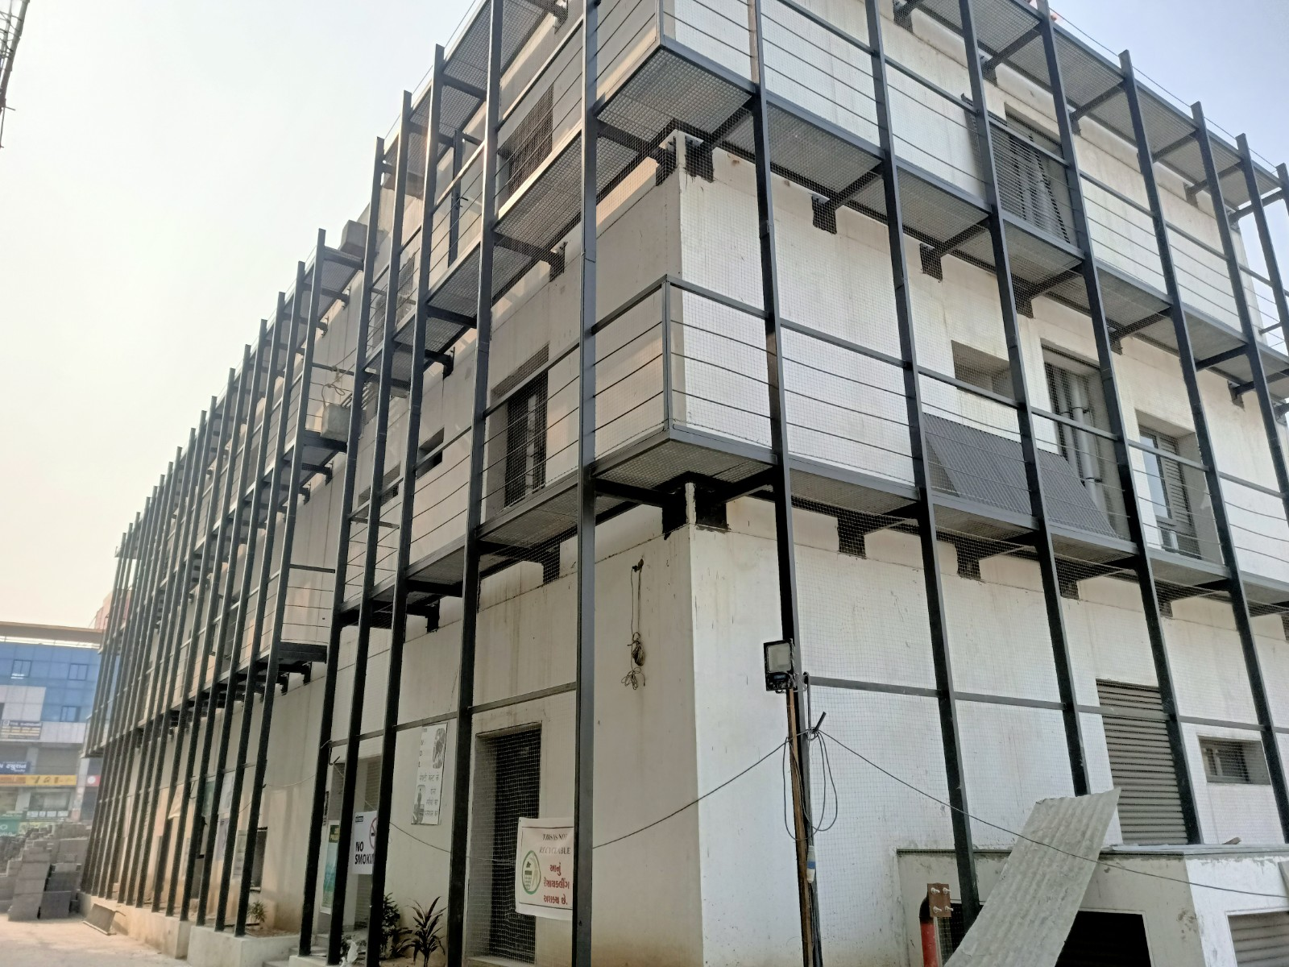
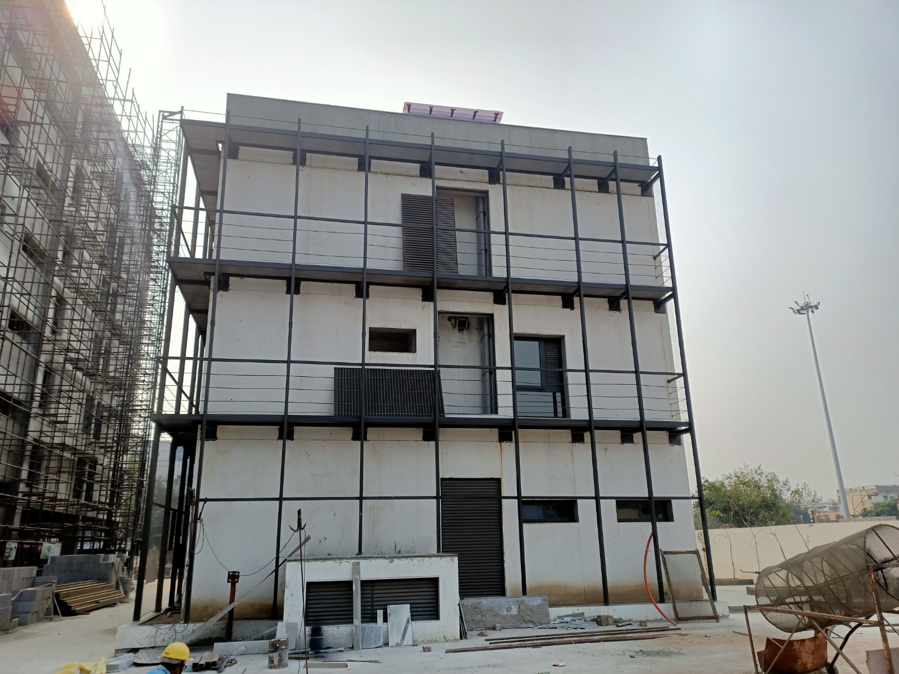
PROJECT CURRENT STATUS PHOTO’S
Plug Building
PROJECT REVIEW MEETING Jan’22

Slide 10
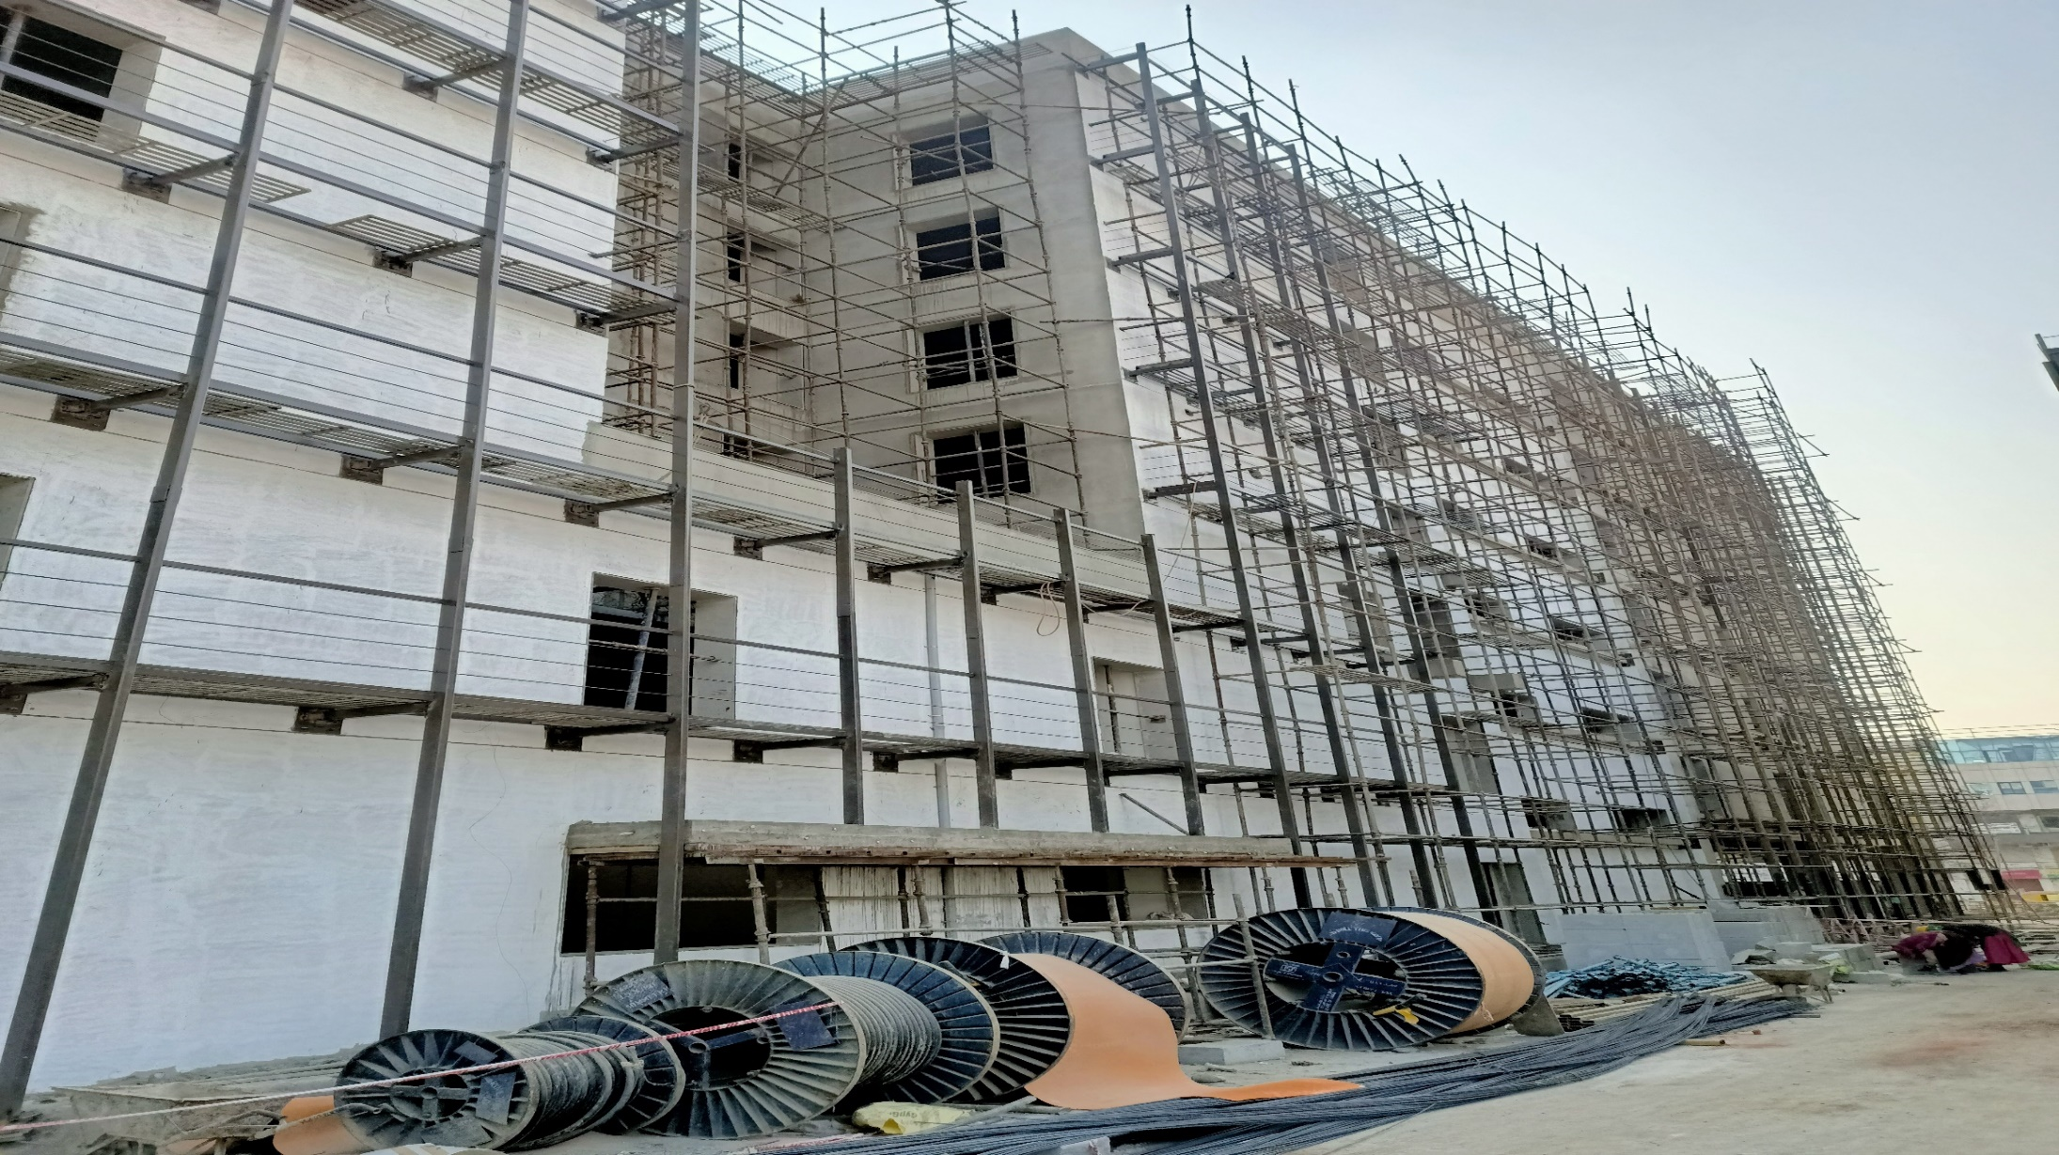
PROJECT CURRENT STATUS PHOTO’S
PSC Building
PROJECT REVIEW MEETING Jan’22

Slide 11
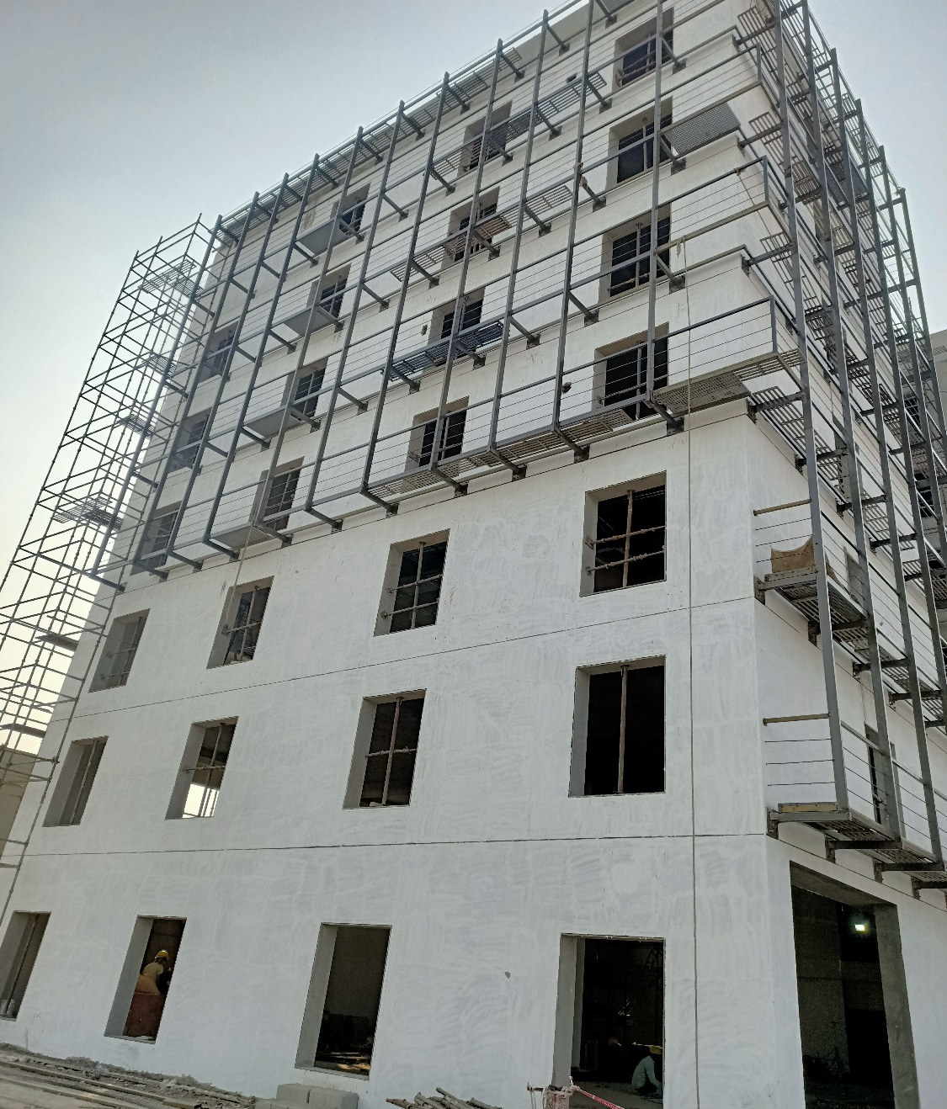
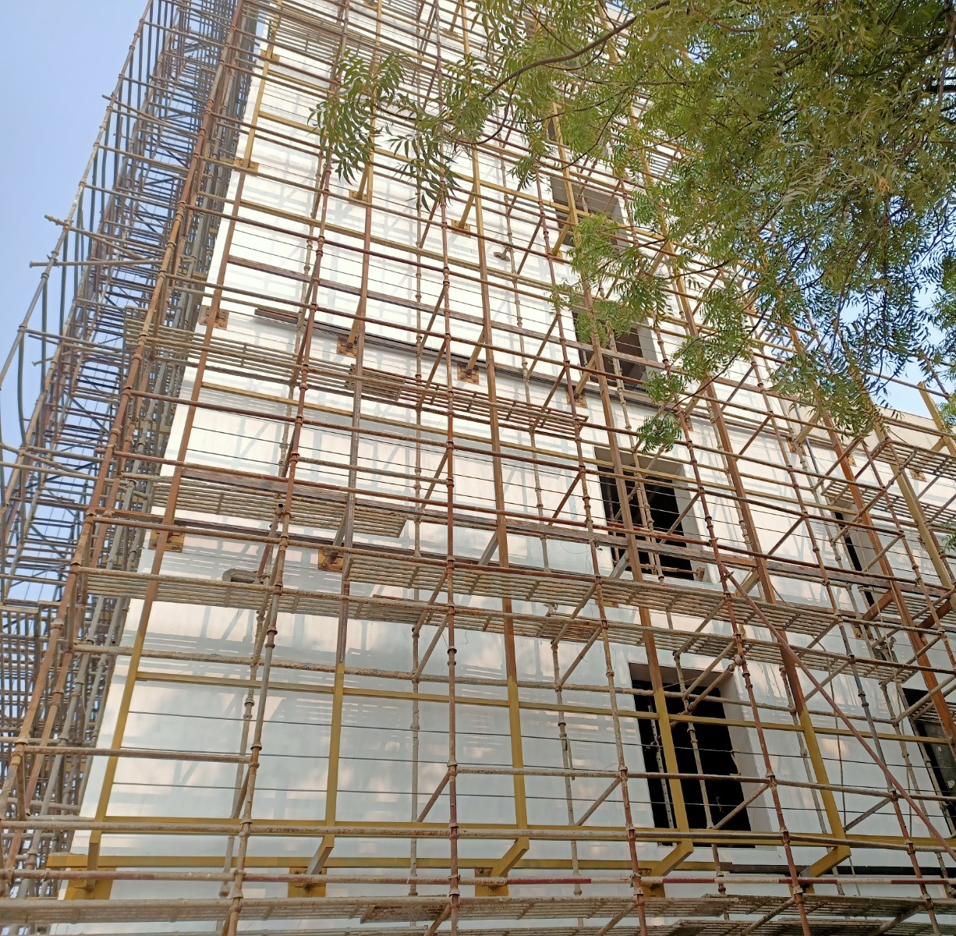
PROJECT CURRENT STATUS PHOTO’S
PSC Building
PROJECT REVIEW MEETING Jan’22

Slide 12
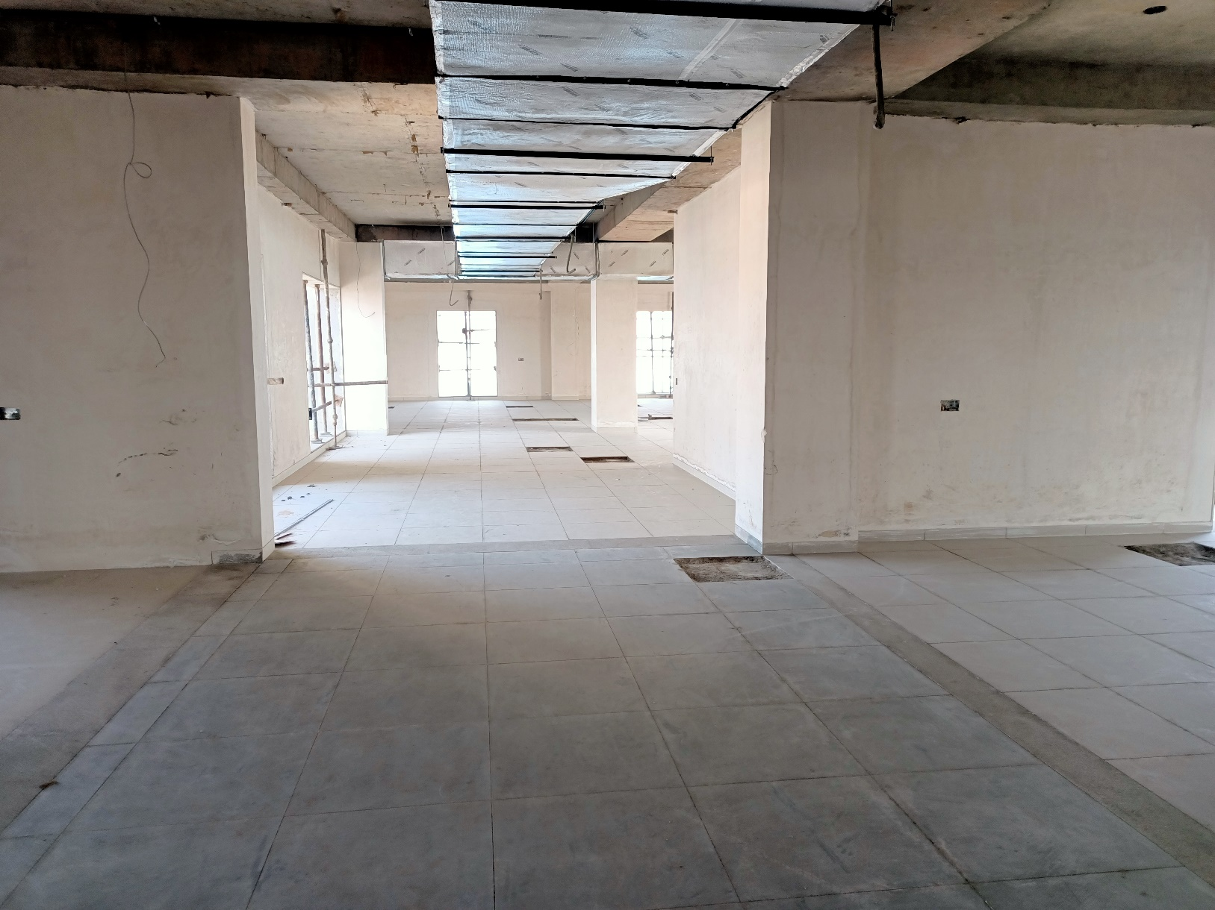
PROJECT CURRENT STATUS PHOTO’S
PSC Building
PROJECT REVIEW MEETING Jan’22

Slide 13
SUPPORT FROM HEAD OFFICE
PROJECT REVIEW MEETING Jan’22

